Slide 1

YOLO
You Only Look Once:
Unified, Real-Time Object Detection
Joseph Redmon, Santosh Divvala, Ross Girshick, Ali Farhadi
University of Washington, Allen Institute for AI, Facebook AI Research
Younghoon Na
Email : nayounghoon0223@gmail.com
Github : younghoonNa@github.com

Slide 2
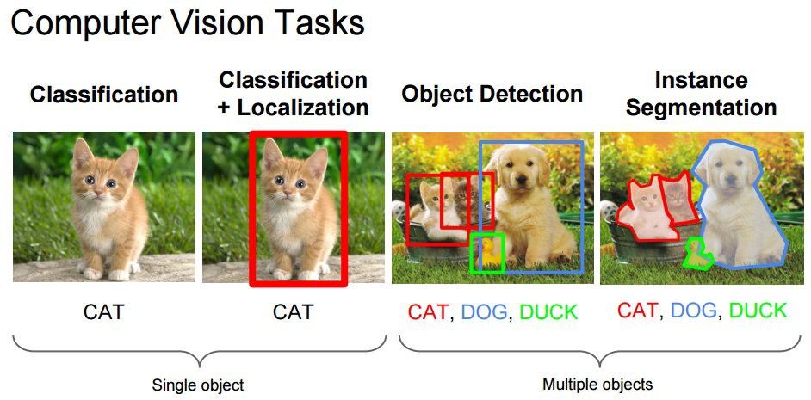
Computer Vision
Obejct Detection -> (Multi-Labeled) Classification + Localization

Slide 3
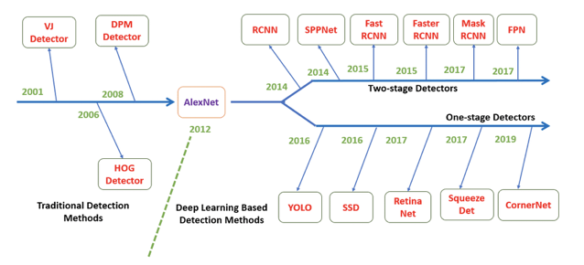
Object Detection

Slide 4
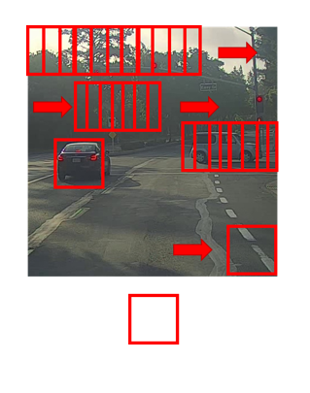
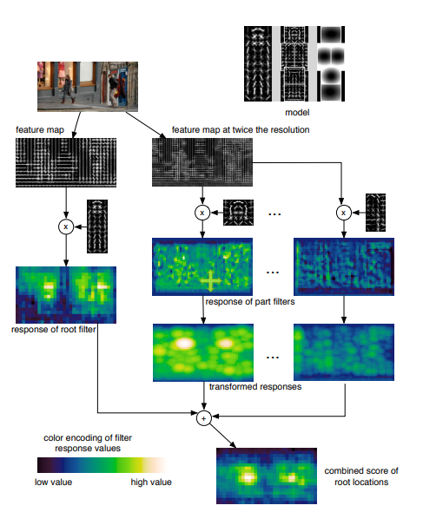
Deformable parts models (DPM)

Slide 5
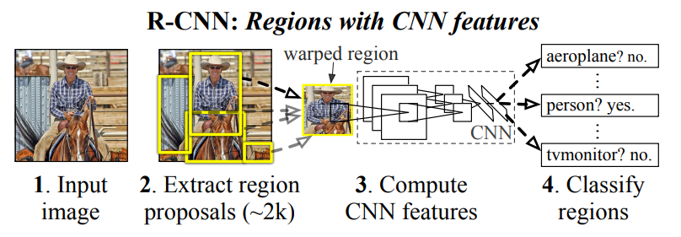
R-CNN(Regions Based Convolutional Neural Networks)
Region proposals
Region Classification

Slide 6
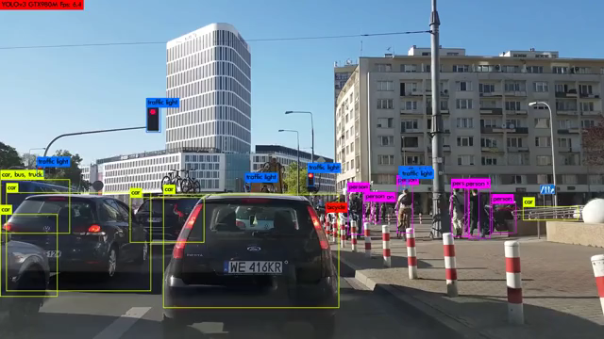
Real-time object detection
https://www.youtube.com/watch?v=MPU2HistivI
실시간 물체 탐지를 위해서는
초당 30프레임, 30FPS 이상 나와야 한다고 한다.

Slide 7
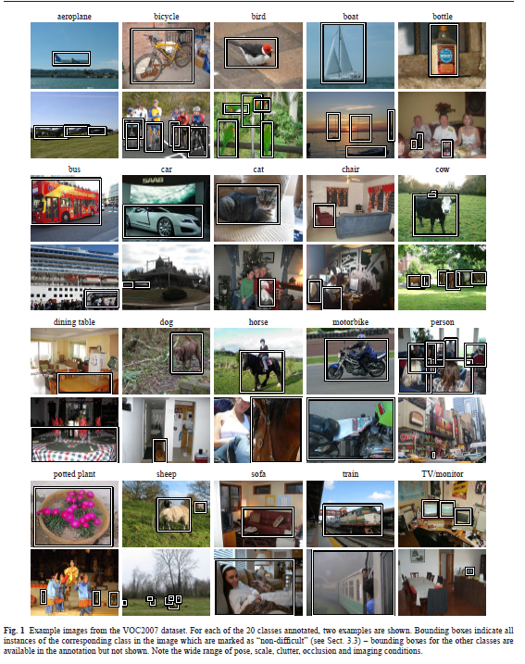
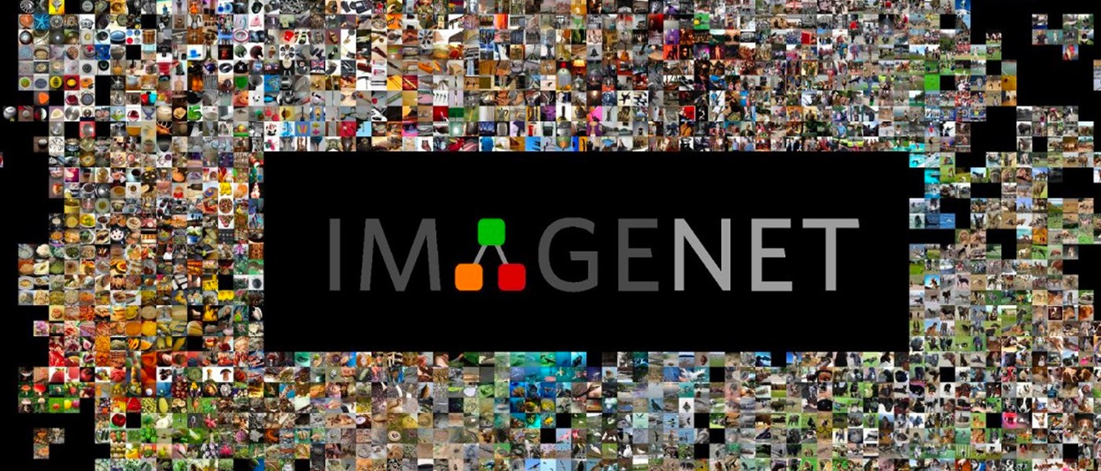
ImageNet & PASCAL
ImageNet 2012
Top-5 Accuracy : 88%
Class 수 : 1000
PASCAL VOC 2007
Class 수 : 20

Slide 8
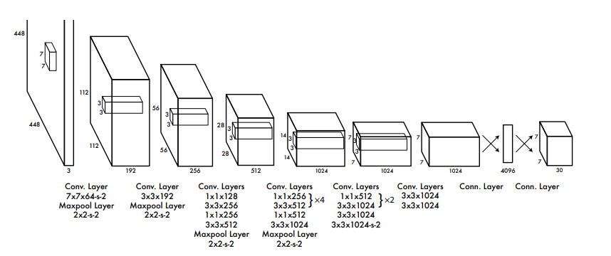
YOLO – Unified Detection
One-state Detector

Slide 9
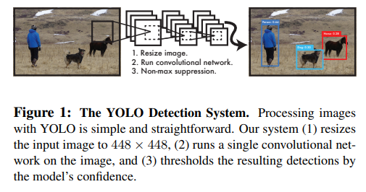
YOLO – Unified Detection

Slide 10
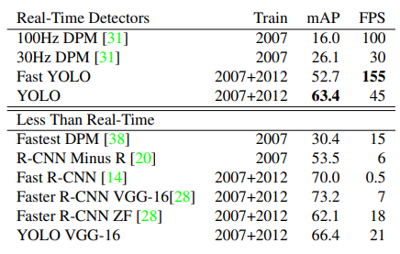
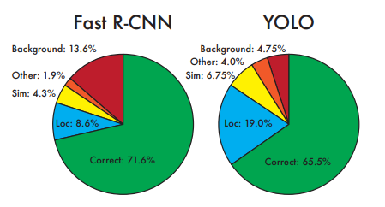
YOLO
FPS mean Frame Rate
GPU : TITAN X

Slide 11
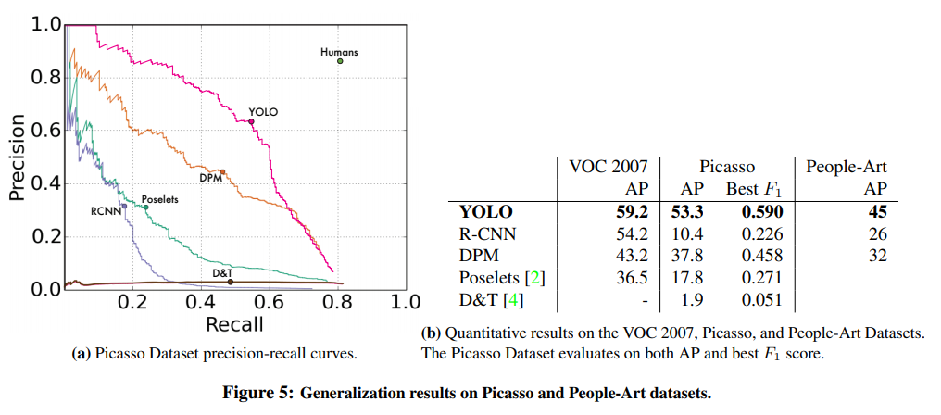
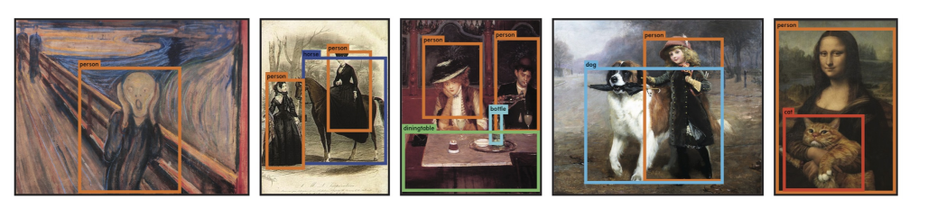
YOLO
Train Data : PASCAL VOC 2007
Precision : 모델이 True라 예측하였을 때 실제 True 비율
Recall : 실제 값이 True일 때 모델의 True 비율

Slide 12
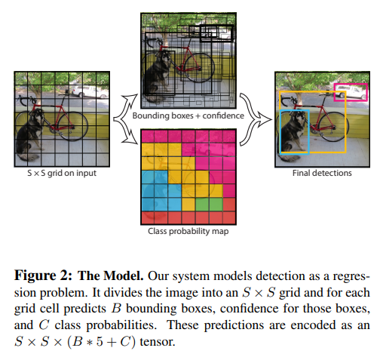
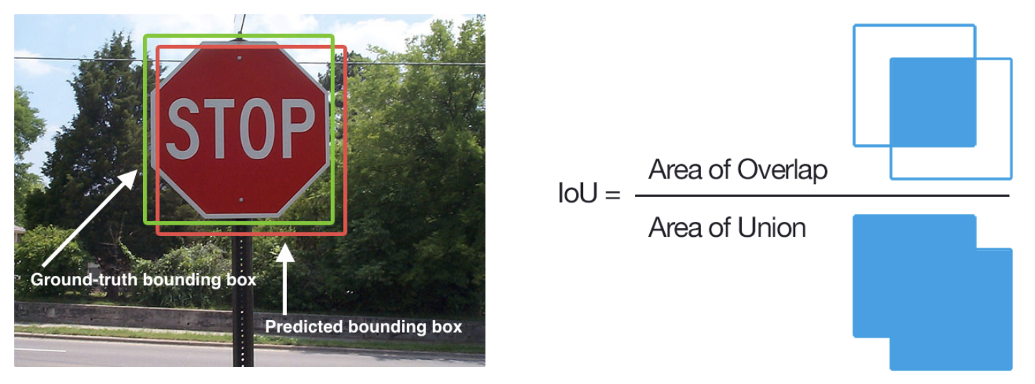
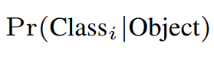
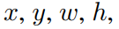
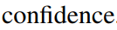
YOLO

Slide 13

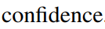
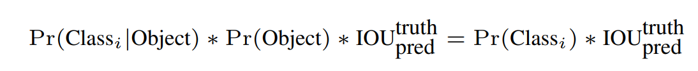
YOLO
If contain object: Pr(object) = 1
else : Pr(object) = 0

Slide 14
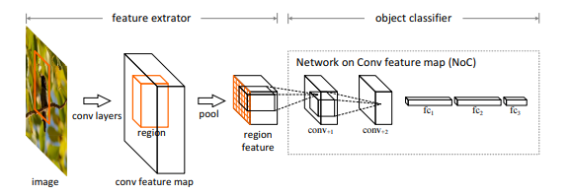
Unified Detection - Training
Pretrain : ImageNet 1000-Classification dataset (224x224)
Fine-tuning : VOC dataset 2007 and 2012 (448x448)
Detection : 448x448
S. Ren, K. He, R. B. Girshick, X. Zhang, and J. Sun.
Object detection networks on convolutional feature maps. CoRR, abs/1504.06066, 2015.
1 | 1 | 4 | 10 | 6 | 2
Conv Layer : 24
Linear Layer : 2
Class probabilities (C = 20)
Bounding box coordinates((x,y,w,h,c) = 5 x (B = 2))

Slide 15
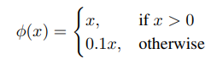
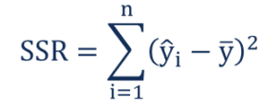
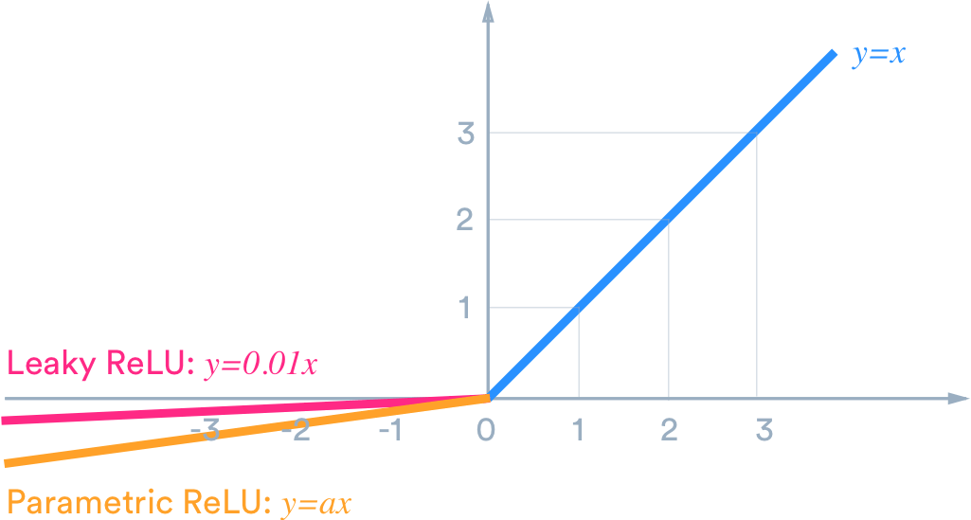
Hyperparater
Linear Activation
-> leaky rectified linear activation
Loss Function
-> Sum-Squared-Error
Easy to optimize
Weights localization equally with classification error
Training diverge early on
- Confidence score will be zero (not contain object)
- Overpowering the gradient (contain object)
4. Weight errors in large box equally small box

Slide 16
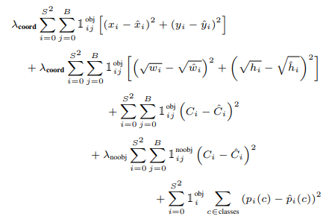
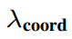
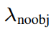
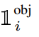
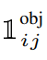
Hyperparater
Loss Function
To solve the problem of equally reflecting weight errors
in large and small boxes
Increase loss from bounding box coordinates predictions
Default = 5
Decrease loss from Confidence predictions that don’t
contain objects for bounding boxes
Default = 0.5
Objects appears in cell I
Jth bounding box predictor in cell i

Slide 17
Hyperparater
Pretrain : ImageNet 1000-Classification dataset (224x224)
Epoch = 135
Batch size = 64
Momentum = 0.9
Weight decay = 0.0005
Dropout = 0.5
Learning Rate Schedule
Default = 0.001
~ 75 epochs = 0.001 -> 0.01
~ 105 epochs = 0.001
~ 135 epochs = 0.0001
Image Augmentation
Translations +
scaling = up to 20%
Random adjust
exposure/saturation
= factor of 1.5 HSV
Fine-tuning : VOC dataset 2007 and 2012
Test : VOC dataset 2012 (also include 2007)
Detection : 448x448
Randomly initialized weighted

Slide 18
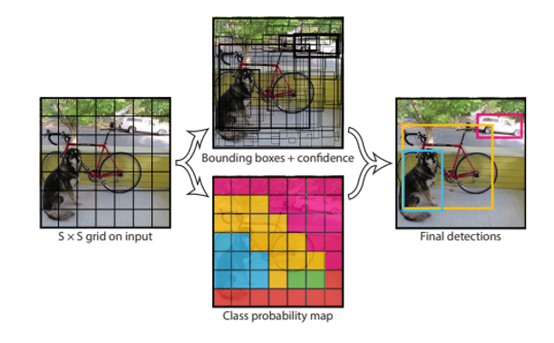
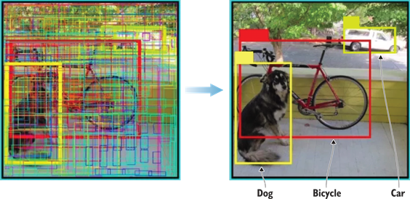
Inference
Testing on PASCAL VOC, predict on 98 bounding boxes
YOLO -> Fast
Only requires a single network
Some large objects or objects near of the boarder of multiple cell
Non-Maximal Suppression

Slide 19
Non-Maximal Suppression
Execution process of NMS
If “Confidence Score” less then threshold -> remove
Descending sort for “Confidence Score”
Select the box with highest “Confidence Score”
Compare the IOU this box with other boxes
Remove the bounding boxes with IOU higher then threshold(0.5)
Select the next box and Repeat 4-6
NMS adds 2-3% in mAP (Mean Average Precision)

Slide 20
YOLO versus DPM

Slide 21
YOLO versus R-CNN
Selective Search

Slide 22
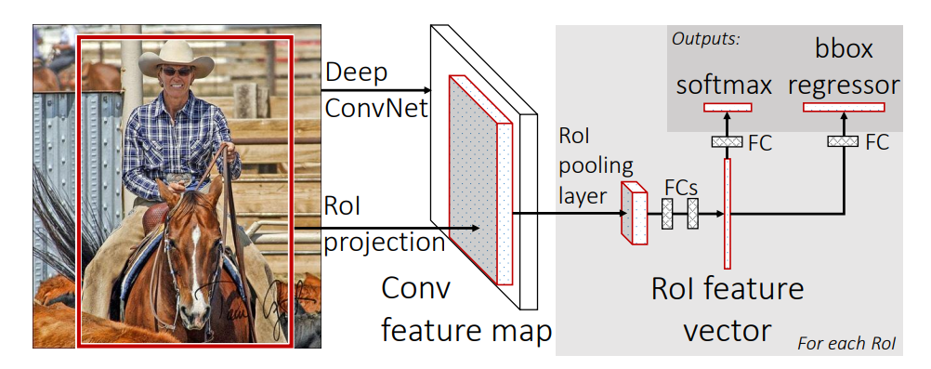
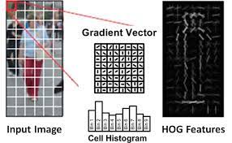
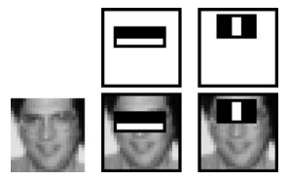
YOLO versus Fast Detectors
“HOG Computation” for speeding up the DPM
Fast, Faster R-CNN
Using Neural Network instead Selective Search
Sharing computation
Robust Real-Time Face Detection

Slide 23
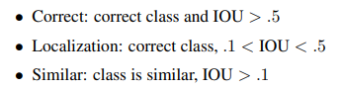
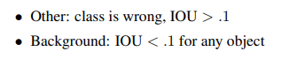
Comparison to Other Real-Time Systems
FPS mean Frame Rate
GPU : TITAN X

Slide 24
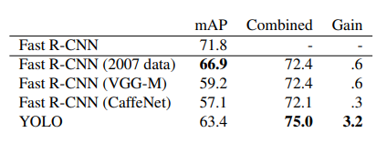
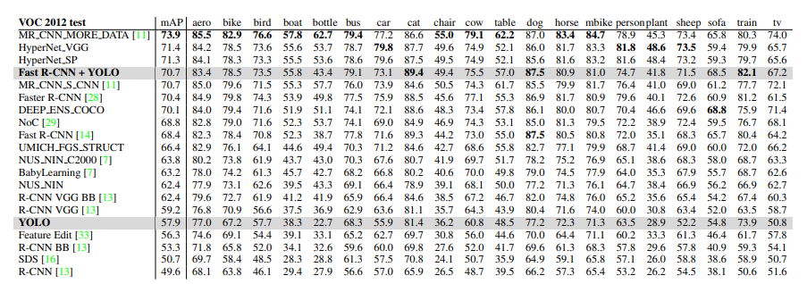
Combining Fast R-CNN and YOLO

Slide 25
Generalizability

Slide 26
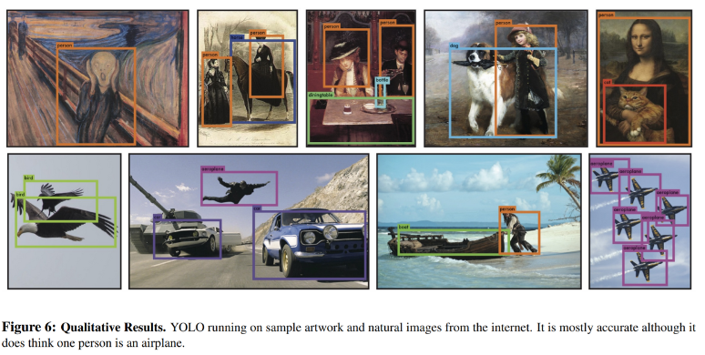
Generalizability

Slide 27
Limitations of YOLO
Since each grid cell only predicts number of B boxes and only have one class
-> struggles with small objects that appear in groups
model learns to predict bounding boxes
-> struggles to generalize to objects in new or unusual aspect ratios or configurations
Our loss function treats errors the same in small boxes versus large bounding boxes
-> incorrect error about localizations

Slide 28
Conclusion
YOLO is simple and fast (Unified detection)
YOLO enables real-time detection
YOLO generalizes well to new domains

